Slide 1
JPEG Compression
Jpeg utility tool (decompression included)
David Harabagiu
30239

Slide 2
How to
Run in a terminal: jpegutils c/d source_image destination_image
Examples:
jpegutils c salam.bmp salam_compresat.bin
jpegutils d salam_compresat.bin salam_decompresat.bmp

Slide 3
How to
You can also use my code in your own application!!
It is written as a module (.cpp and .h pair)
Just import them in your project
There are 2 functions you can use:
void JPEGCompress(char *src, char *dst)
void JPEGDecompress(char *src, char *dst)

Slide 4


Example (before and after compression and decompression)

Slide 5


Let’s have a look a little closer

Slide 6
NEBUNIE!!!

Slide 7
User reviews
M8 I r8 8/8
My dog likes it
Since I began using jpegutils, I made new friends and my hair grew back
I want my money back
How do I use this?
Am ramas prost

Slide 8
Techical Stuff

Slide 9
Libraries used
C++ Standard Library
OpenCV

Slide 10
How does it work? (compression steps)
Transform the RGB image to the YCbCr color space. Y = luminance; Cb = Blue difference chroma; Cr = Red difference chroma. This color space has the advantage that color information is treated separately and can be downsampled, compressed more than the Y component. This can be done without affecting the appearance of the image too much because the human eye is not very sensitive to color changes, as opposed to light intensity changes.
Subtract 128 from the Y component, to bring Y to the [-128, 127] range. Cb and Cr are already in that range.
Partition the image in 8x8 matrices. If the width of height of the image is not divisible by 2, the image is resized. From now on, the algorithm will work on each 8x8 matrix.

Slide 11
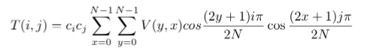
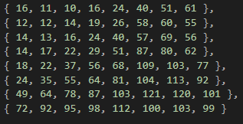
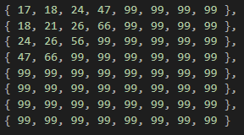
How does it work? (compression steps – cont.)
Apply discrete cosine tranform on each 8x8 matrix, on each channel (Y, Cb, Cr). Use this formula:
Divide each channel by a quantization matrix. The matrix for the Y channel is different from the matrix for the Cb and Cr channels.
For Y
For Cb and Cr

Slide 12
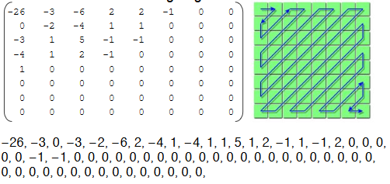
How does it work? (compression steps – cont.)
Order the values from each channel in zigzag order (just the first 32):
Save the ordered coefficients from each 8x8 matrix and each channel in a file.

Slide 13
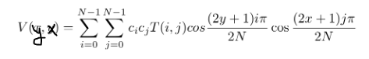
How does it work? (decompression steps)
Read the file with the compressed image
Take the coefficients and put them back in each 8x8 matrix in zigzag order
Multiply each 8x8 matrix channel by their respective quantization matrix
Apply inverse discrete cosine transform:
Glue all the 8x8 matrices together
Add 128 to the Y channel
Transform back the the RGB color space

Slide 14
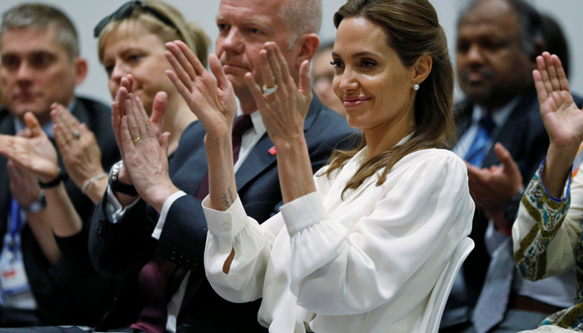
GG EZ

Slide 15

More boring stuff

Slide 16
Algorithm Partitioning + FDCT + Quantization
for br from 0 to src.rows - 1 step 8 for bc from 0 to src.cols – 1 step 8 for i from 0 to 7 for j from 0 to 7 ny <- 0; ncb <- 0; ncr <- 0 for x from 0 to 7 for y from 0 to 7 ny <- ny + (src(br+y,bc+x).Y – 128) * cos((2y+1)*i*PI/16) * cos((2x+1)*j*PI/16) ncb <- ncb + src(br+y,bc+x).Cb * cos((2y+1)*i*PI/16) * cos((2x+1)*j*PI/16) ncr <- ncr + src(br+y,bc+x).Cr * cos((2y+1)*i*PI/16) * cos((2x+1)*j*PI/16) if i = 0 then ci <- sqrt(1/8) else ci <- sqrt(2/8) if j = 0 then cj <- sqrt(1/8) else cj <- sqrt(2/8) dst(br+i,bc+j).Y <- round(ny * ci * cj / QY(i,j)) dst(br+i,bc+j).Cb <- round(ncb * ci * cj / QC(i,j)) dst(br+i,bc+j).Cr <- round(ncr * ci * cj / QC(i,j))

Slide 17
Algorithm explained a bit
These will iterate through each 8x8 partition:
for br from 0 to src.rows - 1 step 8 for bc from 0 to src.cols – 1 step 8
These will iterate through each pixel in that partition:
for i from 0 to 7 for j from 0 to 7
These will calculate the sums for each pixel:
for x from 0 to 7 for y from 0 to 7
Ci and Cj according to the formula:
if i = 0 then ci <- sqrt(1/8) else ci <- sqrt(2/8) if j = 0 then cj <- sqrt(1/8) else cj <- sqrt(2/8)
Multiply each channel by ci and cj, then divide with the value from the quantization matrix:
dst(br+i,bc+j).Y <- round(ny * ci * cj / QY(i,j)) dst(br+i,bc+j).Cb <- round(ncb * ci * cj / QC(i,j)) dst(br+i,bc+j).Cr <- round(ncr * ci * cj / QC(i,j))

Slide 18

Now you can wake up

